Slide 1
Research Methods in Psychology

Slide 2
Experimental research: construction of research hypothesis; identification of operational independent and dependent variables;
A hypothesis is a testable prediction concerning the possible relationship between two or more variables.
It is NEVER a questions and always a statement.
‘I hypothesis that…’, or in an exam apply to the example e.g ‘Ms Cowan would hypothesis that….’ Both answers are acceptable.
Always operationalize your hypothesis, meaning that you must include:
The IV (and how much it will differ from the DV)
The DV
The Population and Sample
E.g I hypothesis that 100 VCE Psychology students (population) who study for an average of 6 hours (IV) a week, will score 20% higher operationalise DV) on the mid-year exam (DV) than those who do not.

Slide 3
Experimental research: construction of research hypothesis; identification of operational independent and dependent variables; identification of extraneous and potential confounding variables including individual participant differences, order effect, experimenter effect, placebo effect
Independent variable:
- Manipulated by the researcher
- Consists of two or more treatment conditions to which participants are exposed
- Assumed to have a direct effect on the DV
Dependent variable:
- Measured by the researcher
- Observed for changes in order to assess the effect of the treatment
- Assumed to be directly affected by changes in the IV
Extraneous variable:
- Any variable that has the potential to influence the DV in an experiment and therefore bias the results.
- May be associated with the characteristics of the participants, the experimenter or the experimental design.
Confounding variable:
- And variable that does have an unwanted effect on the DV in an experiment. The results are therefore biased and cannot be determined whether they are caused by the IV of the confounding variable.

Slide 4
Experimental research: construction of research hypothesis; identification of operational independent and dependent variables; identification of extraneous and potential confounding variables including individual participant differences, order effect, experimenter effect, placebo effect
Eating a low fat diet will improve physical health
IV: Eating a low fat diet DV: Physical health
That hungry individuals are more likely to perceive food in a series of ambiguous pictures that individuals who are not hungry.
IV: Hunger levels (high and low) DV: No. of times food is perceived
The behaviour modification techniques will be successful in extinguishing tantrum behaviour of children in the classroom
IV: The use od BM techniques DV: Level of extinction of tantrum
That a police car flashing blue lights is more likely to be perceived at night that a police car flashing red lights.
IV: Colour of police lights DV: Perception at night

Slide 5
Experimental research: construction of research hypothesis; identification of operational independent and dependent variables; identification of extraneous and potential confounding variables including individual participant differences, order effect, experimenter effect, placebo effect
Placebo effect (problem)
A positive or therapeutic result due to a participants expectations of the effect of an inactive substance or dummy treatment.
Single blind procedure (method of control for placebo effect)
Design in which the participants are unaware of their research group allocation. Used to avoid contamination of results from bias and preconceptions of the participants.
Experimenter effect (problem)
Where the expectations of preconceptions of the experimenter bias the results, but either consciously or unconsciously revealing the desired outcome of the experiment, or through unconscious procedural or recording bias.
Double blind procedure (method of control for experimenter effect)
Design in which neither the experimenter not the participants are aware of the allocation of participants to research groups.
Used to avoid contamination of results from biases and preconceptions fo the experimenter or participants.

Slide 6
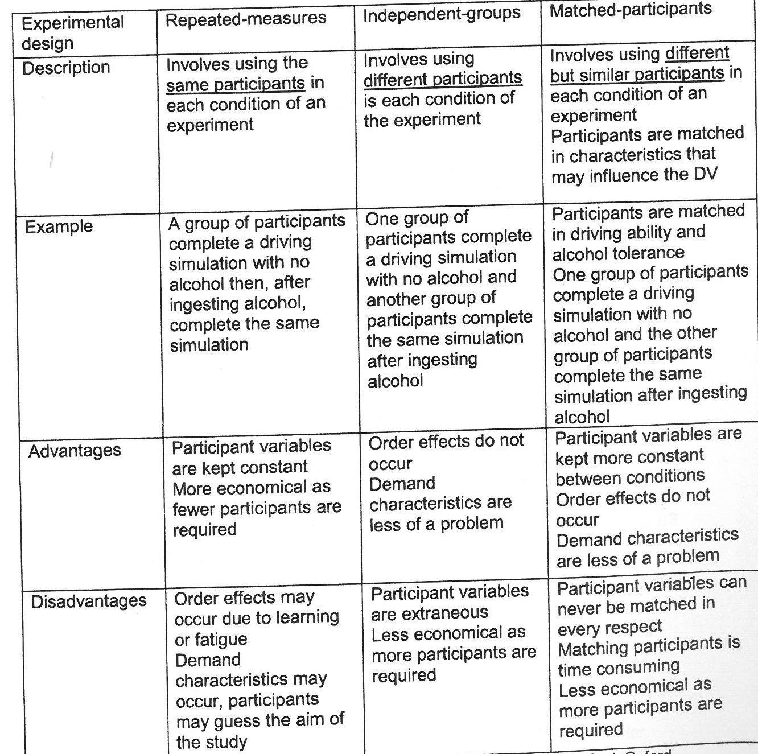
Experimental research: evaluation of different types of experimental designs including independent-groups, matched participants, repeated measures

Slide 7
Experimental research: counter balancing
In repeated measures designs, confounding variable can occur because all participants undergo BOTH conditions. So participants might get tired or bored, or they may improve because they have had a ‘practice’. Counterbalancing ‘cancels out’ this effect.
It involves allocating participants to groups and presenting the IV in a different order. All participants still undergo each condition of the IV, but in a different order.

Slide 8
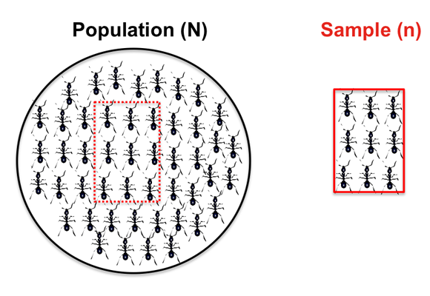
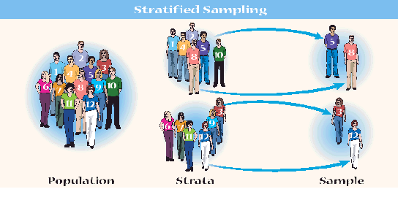
Sampling procedures in selection and allocation of participants: random sampling, stratified sampling, random-stratified sampling; random allocation of participants into groups; control and experimental groups.
The process of selecting participants for a study
from a population of interest is known as a sample.
Convenience Sampling is the process of selecting
participants who are easily obtainable.
E.G: Cohuna Secondary College
Random Sampling allocates participants from the population of interest in such a way that each member of the population has an equal chance of being selected.
Stratified Sampling attempts to prevent biases by making the sample more representative of the population. This involves
identifying some of the relevant factors (strata)
present in a population such as age, sex etc. then
Selecting a separate sample from each group.

Slide 9
Sampling procedures in selection and allocation of participants: random sampling, stratified sampling, random-stratified sampling; random allocation of participants into groups; control and experimental groups.
Random allocation is a means of experimental control which is used to place participants into groups. Random allocation ensures that the participants selected for the experiment are equally likely to be placed in any of the groups in the experiments.
In the experimental group, participants are exposed to the IV.
In the control group, participants are NOT exposed to the IV, and this group is used as a standard of comparison against the experimental group. This allows to researcher to determine whether is was the IV that has affected the DV.

Slide 10
Techniques of qualitative and quantitative data collection: case studies; observational studies; self-reports; questionnaires; interviews; brain imaging and recording technologies.
Quantitative Data is numerical data, usually collected through experimental research.
Qualitative Data is descriptive data (words), usually collected through non-experimental methods such as case studies, observational studies, self-reports, questionnaires and interviews.
Subjective data is obtained by self-report measures in which subjects give verbal or written responses to a series of research questions e.g a survey on dreams.
Objective data is data that has been gathered using systematic observation which is not influenced by any personal bias e.g brain images or a test score.

Slide 11
Statistics: measures of central tendency including mean, median and mode; interpretation of p-values and conclusions; reliability including internal consistency; validity including construct and external; evaluation of research in terms of generalising the findings to the population.
Measures of Central Tendency: Mean, Median & Mode.
Measures of central tendency are statistics that indicate information about the middle scores of a data set.
The mean is the average score. It is the most ‘sensitive’ measure of central tendency but it can become easily distorted by extreme or ‘freak’ values.
The median is the middle point in a set of data.
The mode is the most frequently occurring score in a set of data. Some distributions may have more that one mode.
Measures of dispersion include the range and standard deviation.

Slide 12
Statistics: measures of central tendency including mean, median and mode; interpretation of p-values and conclusions; reliability including internal consistency; validity including construct and external; evaluation of research in terms of generalising the findings to the population.
Inferential statistics are formal data analysis that measure the likehood of results obtained for a study occurring by chance.
Measures of statistical significance indicate whether the results obtained in an experiment do not occur by chance and therefore may be attributed to other variables
If the results are significant then they are supporting the hypothesis
A p value represents the probability level which forms the basis for deciding whether chance factors are responsible for the results obtained.
A significant result is one where there is a low probability that chance factors were responsible for any observed difference.
A 0.05 significance level occurs when the probability of chance is five or fewer times in a 100 repetitions of the research.

Slide 13
Statistics: measures of central tendency including mean, median and mode; interpretation of p-values and conclusions; reliability including internal consistency; validity including construct and external; evaluation of research in terms of generalising the findings to the population.
P = < 0.05 means
‘The probability that this difference would occur by chance alone is less than 5%’
So if p is set at <0.05 and the experiment finds a p value of p=0.02 then the difference is statistically significant and the hypothesis is supported.
This means that the probability was less ot equal to 5 in 100 that the results were due to chance.
If the experiment finds a p value of p=0.06 then the difference is not statistically significant and there would be a null hypothesis.

Slide 14
Statistics: measures of central tendency including mean, median and mode; interpretation of p-values and conclusions; reliability including internal consistency; validity including construct and external; evaluation of research in terms of generalising the findings to the population.
P< 0.05 p= 0.03
Hypothesis is supported
P<0.05 p= 0.05
Hypothesis is supported
P<0.03 p = 1.3
Null hypothesis
P< 0.04 p = .01
Hypothesis supported
P > 0.05 p = .06
Hypothesis supported

Slide 15
Statistics: measures of central tendency including mean, median and mode; interpretation of p-values and conclusions; reliability including internal consistency; validity including construct and external; evaluation of research in terms of generalising the findings to the population.
A conclusion is drawn based on the results obtained, it draws an inference as to whether the hypothesis has ben supported or rejected. The researchers has to ensure that any change in the DV was solely due to the impact of the IV, rather than any confounding or extraneous variables.
A conclusion applies only to the sample used in research. A researcher can generalise their results beyond their findings.
A generalisation is an application of the conclusion based on the results obtained to a wider population in other similar settings outside the study.
When generalising:
Any uncontrolled variables need to be accounted for. Look at the research design etc.
The p value has to be statistically significant
Reflect on the population & sample size

Slide 16
Statistics: measures of central tendency including mean, median and mode; interpretation of p-values and conclusions; reliability including internal consistency; validity including construct and external; evaluation of research in terms of generalising the findings to the population.
Validity is the extent to which an instrument (or experiment) measures what it supposed to measure.
Internal validity: whether the results gained from a measure are truly due to the variable that it is thought to be measuring
Construct validity: involves deciding whether the instrument can be used to support the theory that is being tested. E.g. does a memory test measure all of the abilities associated with memory (sensory, STM & LTM).
External validity: examines whether the results gained from the sample used in the research can confidently be generalised to the population.
In general laboratory experiments are higher in internal validity and studies in the field are higher in external validity. Why do you think this is so?
Reliability refers to how consistent a measuring instrument is.
Internal reliability refers to the extent to which all the items in a research instrument contribute equally to the final score.

Slide 17
Ethical principles and professional conduct: the role of the experimenter; protection and security of participants tights; confidentiality; voluntary participation; withdrawal rights, informed consent procedures; use of deception in research; debriefing; use of animals in research; role of ethics committees.
Research with animals: Today animal research is allowed, however, there are very strict guidelines. Animals must be protected, pain must be minimised and they must be well cared for.
Advantages of animal research:
No participants effects on the IV as animals are not aware to the purpose of an experiment
Animals and humans are very similar in behaviour, so some results can be generalised
Animals can be used when it is unethical to do so on humans, as scientists primarily have an obligation to humans
Limitations of animal research:
Animals suffer and feel stress, pain and anxiety.
Inflicting suffering upon any creature is unethical
Humans are qualitatively different to humans.

Slide 18
Ethical principles and professional conduct: the role of the experimenter; protection and security of participants rights; confidentiality; voluntary participation; withdrawal rights, informed consent procedures; use of deception in research; debriefing; use of animals in research; role of ethics committees.
The role of an ethics committee is to ensure the well-being of participants. Before beginning a study, researchers must submit detailed plans of their proposal to the Human Research Ethics Committee (HREC) of their university or research institution for approval.
The role of the experimenter: The researcher must always act in a professional manner, making sure that the best interests of the participants, and of society in general are met. These include:
Participants rights (respect for participants)
Confidentiality (privacy). This means that participants must not be identified in any way in terms of test results. Data needs to be securely stored.
Voluntary participation. Participants have the right to refuse to take part in any study. There must not be any pressure to take part in the study.
Withdrawal right. Participants have the right to leave a study at any stage, regardless of the possible effects on the results.
Informed consent: Participants must be given information about a study before they agree to take part in it. For participants under the age of 18, parental consent must also be given

Slide 19
Ethical principles and professional conduct: the role of the experimenter; protection and security of participants rights; confidentiality; voluntary participation; withdrawal rights, informed consent procedures; use of deception in research; debriefing; use of animals in research; role of ethics committees.
Deception. This is only permitted if the results would be confounded if the participants had too much information before taking part in the study The researcher must ensure that participants do not unexpectedly suffer distress, and the study must be stopped immediately if this occurs. Participants must be fully debriefed when the study is complete.
Debriefing occurs after the completion of the study and participants are told the results and the conclusions of the study. Any erroneous beliefs about the study are corrected, especially if there was any deception involved. Participants are informed of the availability of and how to obtain counselling if they feel they need it.

Slide 20
Exam Tips
Read the question/research carefully and highlight/underline key information as you read such as:
Population
Sample
IV & DV
Any extraneous and/or confounding variables
The results/findings of the research
Key statistics such as p values
I guarantee that you WILL have to
Write an operational hypothesis
Outline the limitations of the study (conclusions & generalisations)
Reflect on a p value
Discuss the results (in relation to the hypothesis). Why it was/was not supported
THE FOLLOWING SLIDES CONTAIN THE MARKING CRITERIA FOR A RESEARCH METHODS EXTENDED RESPONSE QUESTION.

Slide 21
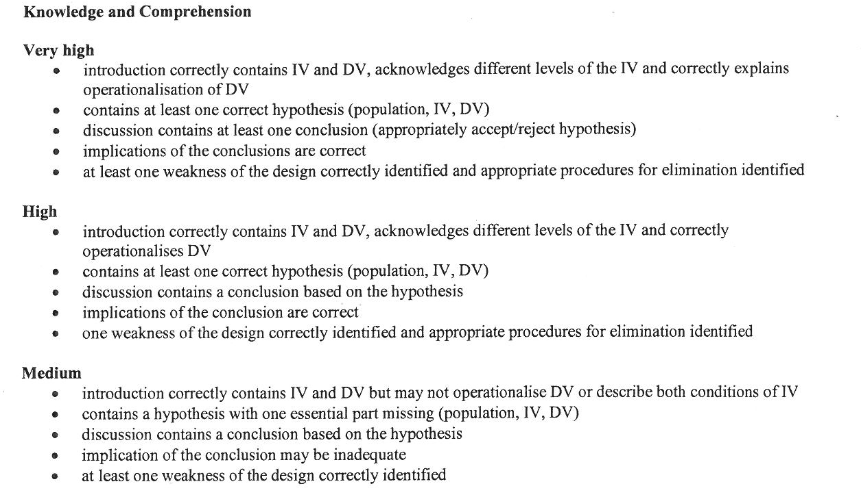

Slide 22
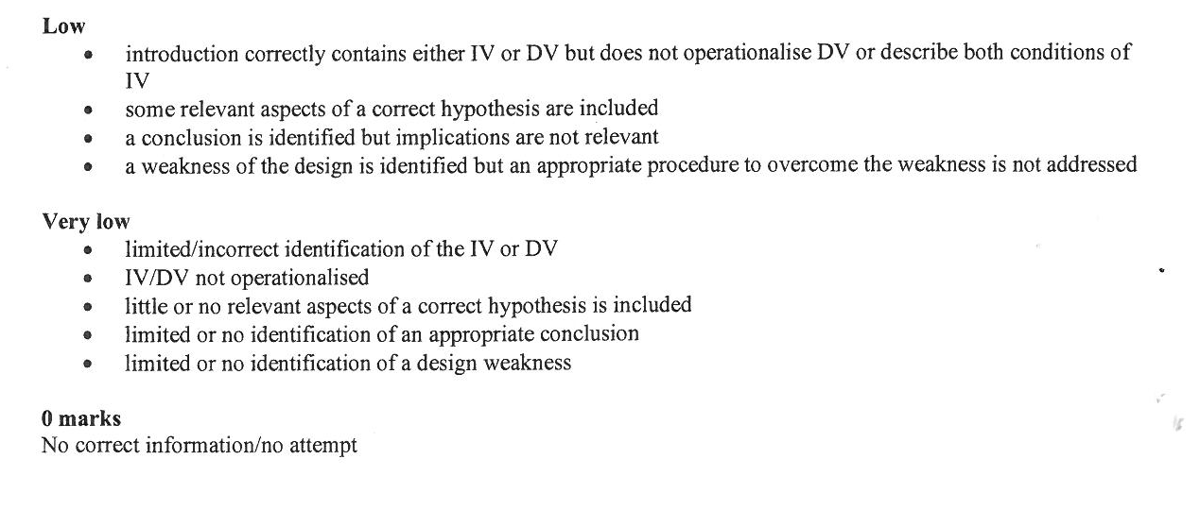

Slide 23


Slide 24
